Slide 1
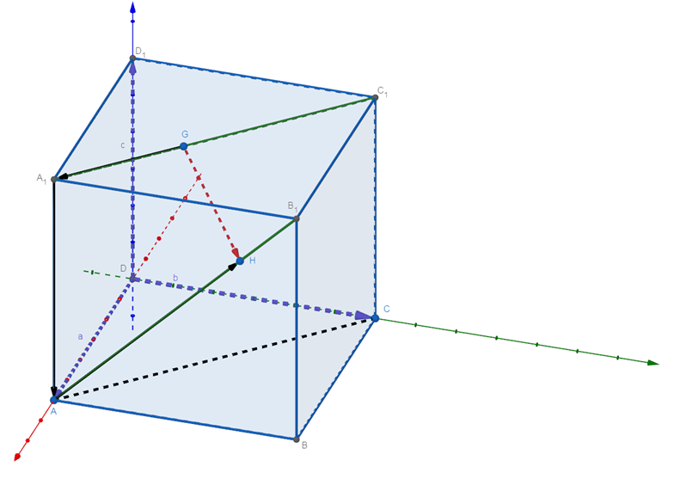
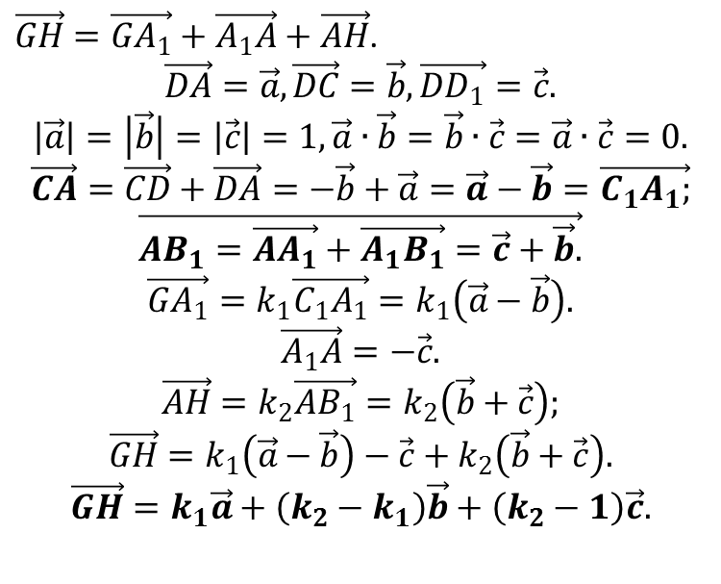
Векторний спосіб
$\vec{GH}=\vec{GA_{1}}+\vec{A_{1}A}+\vec{AH}$.
$$\vec{DA}=\vec{a}, \vec{DC}=\vec{b}, \vec{DD_{1}}=\vec{c}.$$
$$\left|\vec{a}\right|=\left|\vec{b}\right|=\left|\vec{c}\right|=1, \vec{a}∙\vec{b}=\vec{b}∙\vec{c}=\vec{a}∙\vec{c}=0.$$
$$\vec{CA}=\vec{CD}+\vec{DA}=−\vec{b}+\vec{a}=\vec{a}−\vec{b}=\vec{C_{1}A_{1};}$$
$$\vec{AB_{1}=\vec{AA_{1}}+\vec{A_{1}B_{1}}=\vec{c}+\vec{b}.}$$
$$\vec{GA_{1}}=k_{1}\vec{C_{1}A_{1}}=k_{1}\left(\vec{a}−\vec{b}\right).$$
$$\vec{A_{1}A}=−\vec{c}.$$
$$\vec{AH}=k_{2}\vec{AB_{1}}=k_{2}\left(\vec{b}+\vec{c}\right);$$
$$\vec{GH}=k_{1}\left(\vec{a}−\vec{b}\right)−\vec{c}+k_{2}\left(\vec{b}+\vec{c}\right).$$
$$\vec{GH}=k_{1}\vec{a}+\left(k_{2}−k_{1}\right)\vec{b}+\left(k_{2}−1\right)\vec{c}.$$

Slide 2
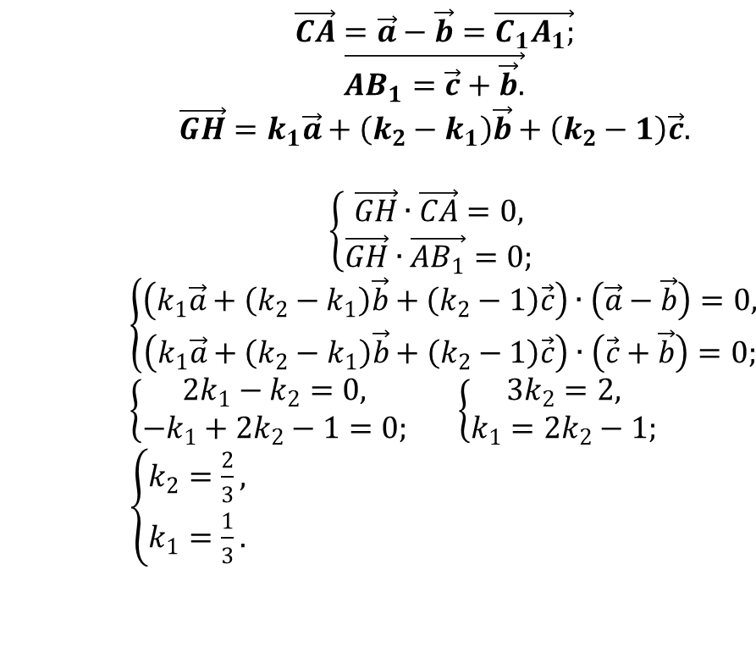
Векторний спосіб
$$\vec{CA}=\vec{a}−\vec{b}=\vec{C_{1}A_{1};}$$
$$\vec{AB_{1}=\vec{c}+\vec{b}.}$$
$$\vec{GH}=k_{1}\vec{a}+\left(k_{2}−k_{1}\right)\vec{b}+\left(k_{2}−1\right)\vec{c}.$$
$$\left\{\begin{aligned}\vec{GH}∙\vec{CA}=0, \\ \vec{GH}∙\vec{AB_{1}}=0;\end{aligned}\right.$$
$$\left\{\begin{aligned}\left(k_{1}\vec{a}+\left(k_{2}−k_{1}\right)\vec{b}+\left(k_{2}−1\right)\vec{c}\right)∙\left(\vec{a}−\vec{b}\right)=0, \\ \left(k_{1}\vec{a}+\left(k_{2}−k_{1}\right)\vec{b}+\left(k_{2}−1\right)\vec{c}\right)∙\left(\vec{c}+\vec{b}\right)=0;\end{aligned}\right.$$
$\left\{\begin{aligned}2k_{1}−k_{2}=0, \\ −k_{1}+2k_{2}−1=0;\end{aligned}\right.$ $\left\{\begin{aligned}3k_{2}=2, \\ k_{1}=2k_{2}−1;\end{aligned}\right.$ $\left\{\begin{aligned}k_{2}=\frac{2}{3}, \\ k_{1}=\frac{1}{3}.\end{aligned}\right.$

Slide 3
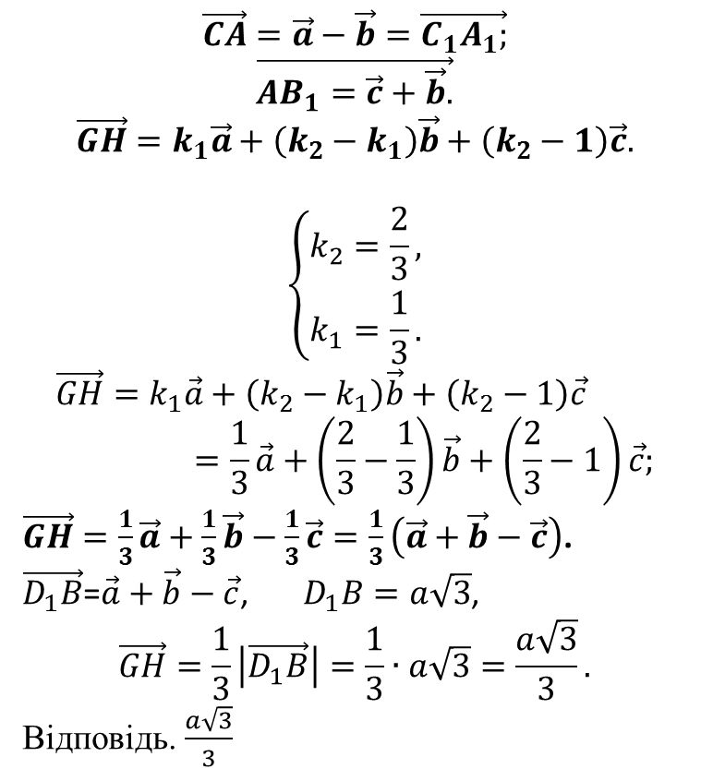
Векторний спосіб
$$\vec{CA}=\vec{a}−\vec{b}=\vec{C_{1}A_{1};}$$
$$\vec{AB_{1}=\vec{c}+\vec{b}.}$$
$$\vec{GH}=k_{1}\vec{a}+\left(k_{2}−k_{1}\right)\vec{b}+\left(k_{2}−1\right)\vec{c}.$$
$$\left\{\begin{aligned}k_{2}=\frac{2}{3}, \\ k_{1}=\frac{1}{3}.\end{aligned}\right.$$
$$\vec{GH}=k_{1}\vec{a}+\left(k_{2}−k_{1}\right)\vec{b}+\left(k_{2}−1\right)\vec{c}=\frac{1}{3}\vec{a}+\left(\frac{2}{3}−\frac{1}{3}\right)\vec{b}+\left(\frac{2}{3}−1\right)\vec{c};$$
$\vec{GH}=\frac{1}{3}\vec{a}+\frac{1}{3}\vec{b}−\frac{1}{3}\vec{c}=\frac{1}{3}\left(\vec{a}+\vec{b}−\vec{c}\right)$.
$\vec{D_{1}B}$=$\vec{a}+\vec{b}−\vec{c}$, $D_{1}B=a\sqrt{3}$,
$$\vec{GH}=\frac{1}{3}\left|\vec{D_{1}B}\right|=\frac{1}{3}∙a\sqrt{3}=\frac{a\sqrt{3}}{3}.$$
Відповідь. $\frac{a\sqrt{3}}{3}$

